Slide 1
UBER SUPPLY DEMAND GAP SUBMISSION
By - Balakrishna Gadiyar

Slide 2
Abstract :
Uber wants to understand supply and demand gap, specifically for Airport Taxis, to avoid loss of revenue.
Uber sees problem in 2 areas.
Non availability of Cars
Cancellations from Drivers.
Business objective:
The objective is to identify the root causes, possible hypothesis of the problems. Recommend ways to improve the situation.

Slide 3
Approach:
Data Cleaning
Load the transaction extract from Uber system
Data Analysis
Create time slots
Data Visualise
Distribution requests on time plot
Format the data and make it ready for analysis.
Univariate analysis with request id and slots
Distribution of requests based on status
Analysis on ride type, slot and duration of request
Derive Metrics
Generate additional columns based on initial analysis
Derive subsets of data based on ride type, slots and volume of request
Distribution of cancelled and non available requests over timescale
Derive heatmap to identify drivers cancelling the trips
Hypothesis and Solution
List the problem points
Suggest recommended solutions

Slide 4
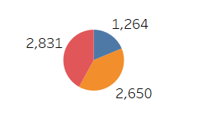
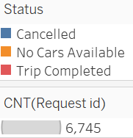
Request Processing Distribution

Slide 5
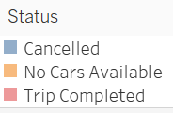
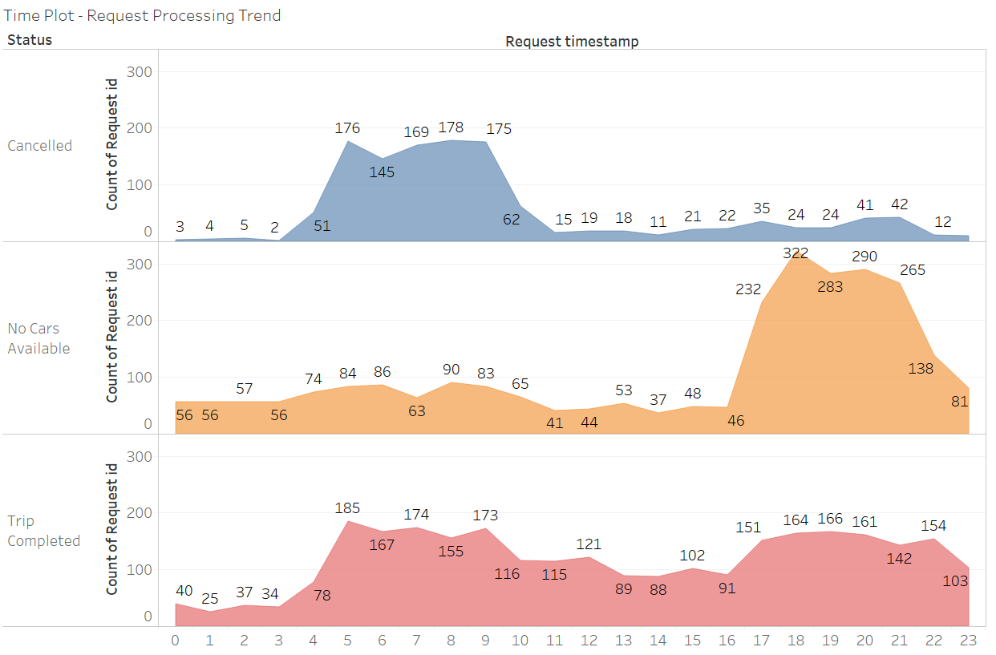
Time plot on request processing based on status

Slide 6
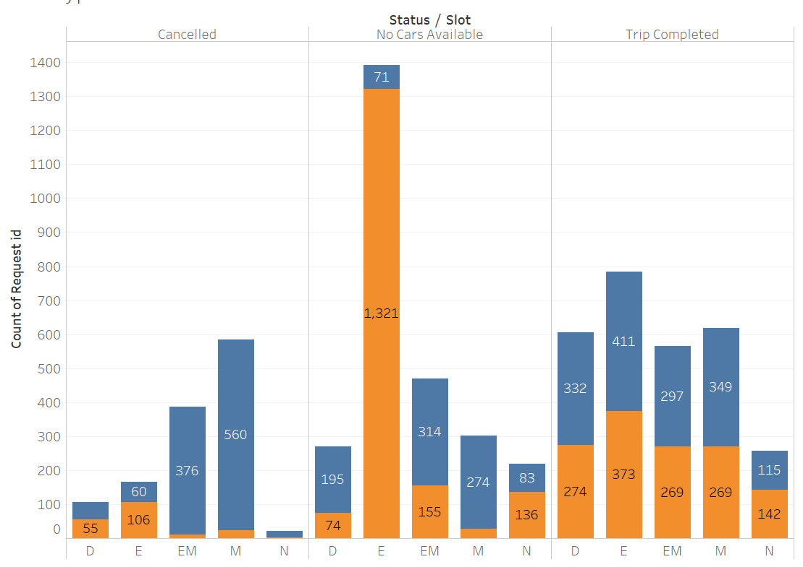

Time Slot Vs Requests Vs Status Vs Riding Direction
E- Evening, till 9 pm
EM – Early Morning, till 6 Am
D – Day Time, till 6 pm
N – Night, till midnight
M- Morning, till 10 Am

Slide 7
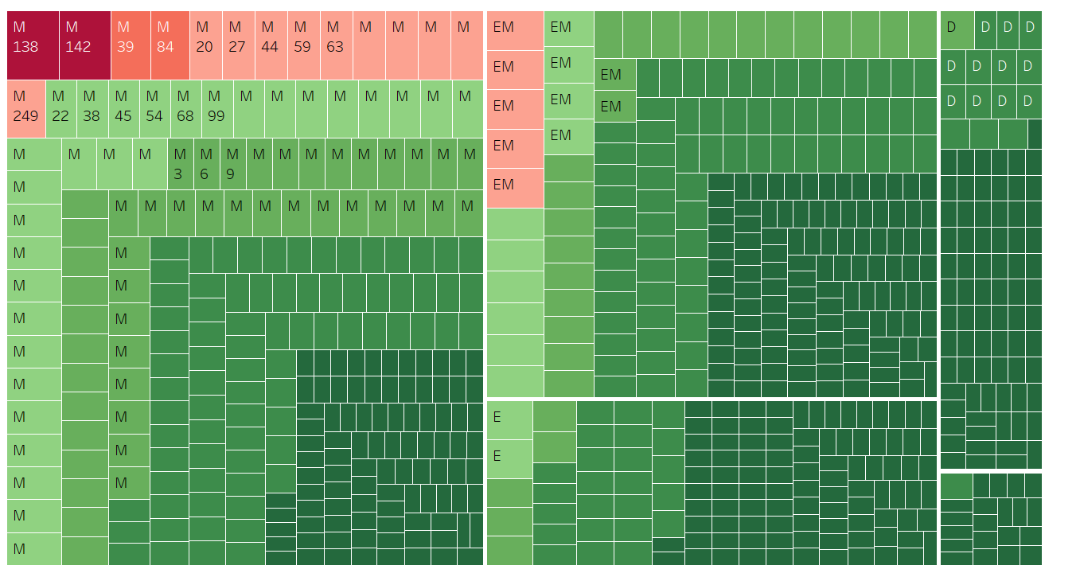
Driver Cancellation Heatmap

Slide 8
Conclusions :
Root cause
Hypothesis
Solution
High demand of cars at airport during evening hours (5-9 PM), but no cabs are available to serve the customers
Cancellation of requests are high in the morning hours (5-10AM)
High international departure in the morning hence high demand. But driver is reluctant to go to airport could be due to idle time after drop
More arrival at airport in the evening and cabs routed towards airport are also less
Provide surge price feature in high demand slot
Provide more incentives for time slots where demand is more
Provide self driven vehicles with higher premium rates
Include other means of transport such as auto rikshaws
More rejections from specific set of drivers, during the morning hours.

